Slide 1
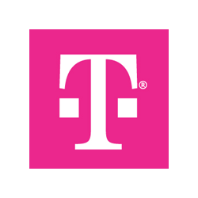
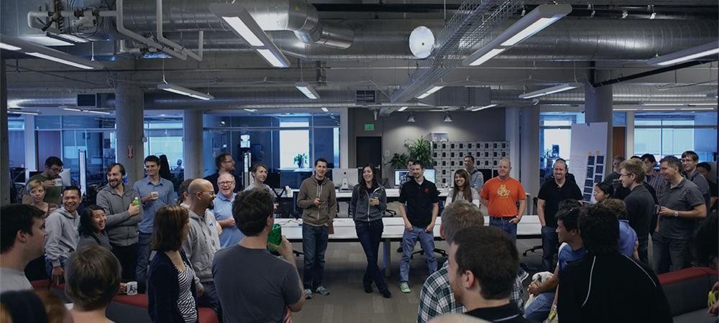
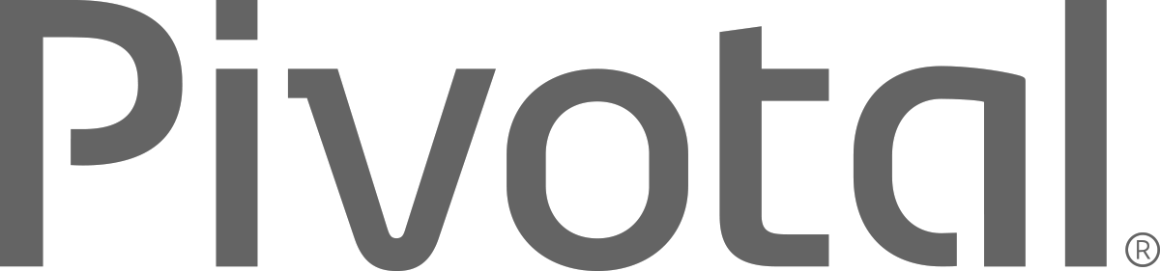
Introductions
Name, Team, Apps

Slide 2


Cloud Native Applications
Introduction, Agenda, and Pivotal Cloud Foundry at T-Mobile
Notes:
Resting slide on screen before you begin presenting.

Slide 3
Workshop Agenda
Workshop Agenda
Cloud Native 101 Review
Boeing Cloud Foundry

Slide 4
Workshop Agenda
9:30 AM - 10:30 AM Cloud Native & DD Design, Microservices
10:30 AM - 10:45 AM Break
10:45 AM - 12:00 PM Introducing Spring Boot
Lab 1: Building A Spring Boot Application
Polyglot Persistence with Spring Data REST
Lab 2: Adding Persistence to Boot Application
12:00 PM - 12:45 PM Lunch
12:45 PM - 1:30 PM Advancing Spring Boot with Actuator and Profiles
Lab 3: Enhancing Boot Application with Metrics

Slide 5
Workshop Agenda
1:30 PM - 2:45 PM Introducing Spring Cloud Netflix
Spring Cloud Config
Lab 4: Introducing Spring Cloud into Boot Application
2:45 PM - 3:00 PM Break
3:00 PM - 3:45 PM Spring Cloud Netflix - Service Discovery & Load Balancing
Lab 5: Microservice Service Discovery and Load Balancing
3:45 PM - 4:30 PM Spring Cloud Netflix - Circuit Breakers
Lab 6: Microservice Fault Tolerance with Circuit Breakers
4:30 PM Wrap-Up and Closing

Slide 6
DevOPs
Continuous Delivery
Microservices
Not my problem
Separate tools, varied incentives, opaque process
Release once every 6 months
More Bugs in production
Tightly coupled components
Slow deployment cycles
Shared responsibility
Common incentives, tools, process and culture
Release early and often
Higher Quality of Code
Loosely coupled components
Automated deployments

Slide 7

What is Cloud Native?
A term that recognizes that getting software to work in the cloud requires a broad set of components that work together.
It requires an architecture that departs from traditional enterprise application design, such as ‘Microservices’
It requires a Cloud Native platform
Notes:
http://www.informationweek.com/cloud/platform-as-a-service/cloud-native-what-it-means-why-it-matters/d/d-id/1321539

Slide 8
What are Microservices?
If every service has to be updated in concert, it’s not loosely coupled!
Loosely coupled service oriented architecture with bounded contexts
If you have to know about surrounding services you don’t have a bounded context.
Notes:
I presume you’re all familiar with microservices and cloud-native, but quickly, here’s an introduction. They’re loosely coupled, service oriented architecture with bounded contexts.
Because each service can be updated independently, your teams can work in parallel. Because each service is isolated, it’s much easier to automate your testing.

Slide 9
Trend towards new lightweight architectures
Microservices addressing speed to market and cloud scale
MONOLITHIC/LAYERED
MICROSERVICES
Notes:
Enterprise companies in finance and telco industries are embracing microservice and cloud-native models.
There are new architectures emerging atop these lightweight app servers to address the scale, speed and safety: new ways of tackling cloud scale and speed to market. Microservices has emerged from the internet giants as such an alternative: a change in culture, organization structure and technology that allows teams to work more independently, and increase velocity. It’s a key part of cloud-native applications, which we’ll talk about shortly.
Microservices are both a cultural and organizational change as a change in how we design and implement systems.

Slide 10
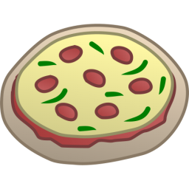
One-Size-Fits-All Methodologies have become an Anti-pattern to the Business
X
HTML
Java
Script
MVC
X
Service
Service
Data Access
Monolithic Application
> 2 Pizzas Per Project = Too Many Pizzas

Slide 11



Apps are Increasingly Refactored as Modularized Software Systems
Microservice based architecture
Relational
DB
Key/Value
Store
AQMP
…..........
Shared
DB
REST
REST
DB Service
Caching Service
Messaging Service
Two Pizzas Per Microservice = Manageable!
Notes:
To build a Microservices architecture at scale requires a platform

Slide 12
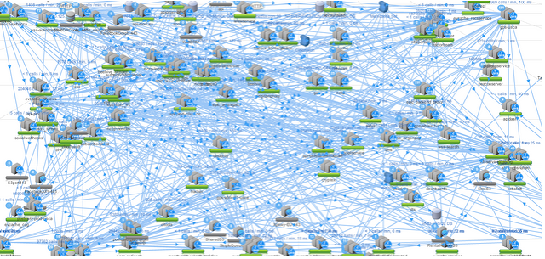

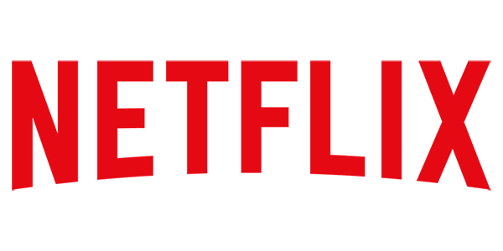
However… Microservices are Hard at Scale
12
Notes:
Distributed systems are HARD
Configuration Management
Service Registration & Discovery
Routing & Load Balancing
Fault Tolerance (Circuit Breakers)
Monitoring
Concurrent API Aggregation & Transformation
----- Meeting Notes (2/24/16 13:58) -----
Dependency Map

Slide 13
The Developer DREAM Haiku
Here is my source code,
Run it in the Cloud for me,
I do not care how
Notes:
An important and in-demand resource these days – Your developers. This is what they really want – to execute on innovation strategic goals without the burden of repetitive tasks, outdated process, and technology which only creates barricades in front of their mission to get into the flow.

Slide 14
It Takes a Platform
An end-to-end structured platform that makes implementing distributed application best practices, a turn-key and first practice
14
Notes:
Mention the opinionated platform.
Structured vs Unstructured.
The word platform is thrown around alot these days. You’ve probably heard the word PaaS a few times already – its become the word of the year already. However, lets make a distinction, structured platforms vs unstructured platforms.

Slide 15
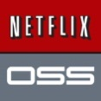

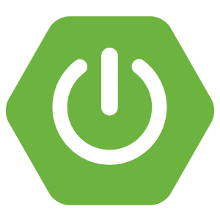

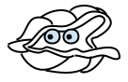




Cloud Native Platform and Contracts
Culture
Framework
Tools
Application Framework
App Dev
Netflix OSS, Docker, Spring, .NET
and others
Contract: 12 Factor App
Container Runtime Platform
Pivotal
Cloud Foundry
PaaS Dev & Ops
Contract: BOSH Release
Infrastructure Automation
bosh.io
IT Ops
Contract: Cloud Provider Interface
Azure
Notes:
And all of this is enforced through strict API contracts that allow you to go FAST and be safe.
Last time we sat down we discussed at a high level what Pivotal provides, today I want to go a bit further into the capabilities of the platform along with its integrations and points of interoperability with external systems. Its important to note that Cloud Foundry is more than a tool, rather it is a cloud native platform, whereby the architecture is purpose built for running apps in the cloud, and itself is cloud agnostic, meaning you can run the same cloud foundry PaaS across any cloud provider. To achieve this, cloud foundry is first and foremost built for running mission critical applications and microservices at scale. It empowers developers by providing the flexibility of working with Docker images, .NET applications, Spring Java, and polyglot languages all within an environment that requires nothing more than a developer to provide code. To enable this, it takes a platform that OOB provides all the logging, APM, Data, High availability, routing, DNS, through an as-a-service approach, interfacing with the underlying infrastructure. That infrastructure can be any cloud provider, and through orchestration, and automation of IaaS functions, can stand up a cloud foundry install with ease. How does a system like this work together? It requires communication, not only between Dev and Ops, but through the layers of App, Platform, and Cloud. The applications run in a platform, abiding by a contract that they be purpose built for the cloud. With frameworks like Spring Boot an app can have profiles which reduce the amount of code to change compatibility with a runtime environment in local or cloud to just a configuration file. Following the best practices set forther by 12factor.net (Heroku), a developer can construct an app to be resiliant, use polyglot persistance, implement netflix battle tested patterns, and deploy configuration changes to an app non disruptivley. On the other side, the platform and onfrastructure itself if made robust through version control of runtime configurations. BOSH our infrastructure automation agent makes versioning your infrastructure configurations a breeze, at the same time keeps the HA of the platform running reliability at all times. To ensure cross cloud compatibility, the BOSH cloud provider interface (CPI) is implemented for the cloud provider’s api. These three things together, Application Framework, Runtime Platform, and Infrasrtucture automation are the key stones fo PCF.

Slide 16
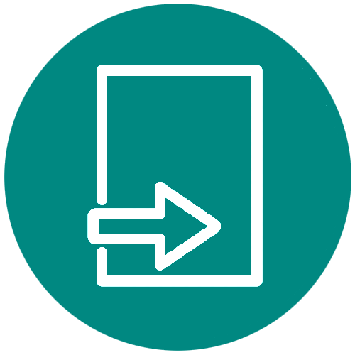
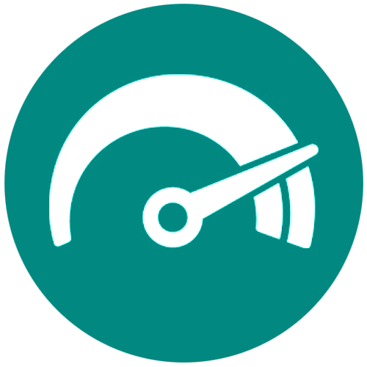

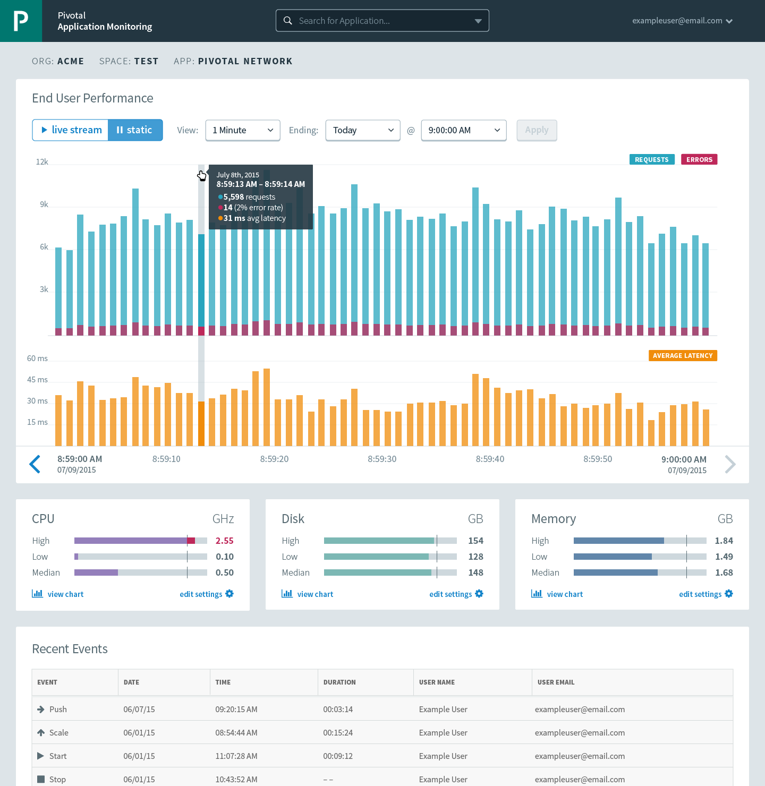

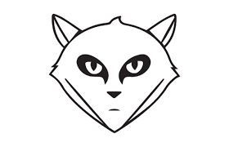
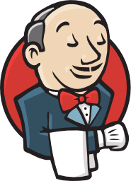

Applications are the new Currency
Data
Services
Centralized Log Management
Networking
& Load Balancing
Auto-Scaling
APM & Tracing
APPLICATION
Health management
Full Stack CI/CD platform
Notes:
Today the application is the new unit of currency in a cloud native world. Since everything is as a service, and full automation is in place, an application is given health management, APM, logging, tracing, data services, load balancing, scaling, availability, and hooks into CI/CD systems. No longer does a developer have to think about managing systems, waiting for tickets, and standing up snowflakes for an app.

Slide 17
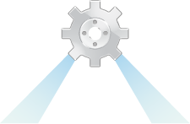
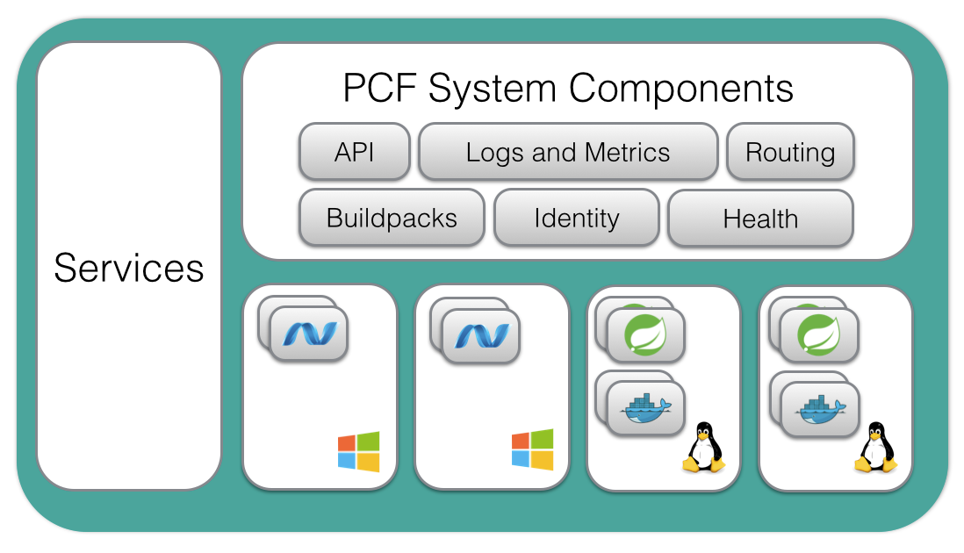
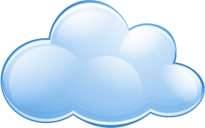



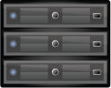
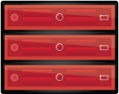
TMUS’ Cloud Foundry
Location
Independent
Polaris* Availability Zones x 3
*.px1.cfapps.internal.t-mobile.com
*.px2.cfapps.internal.t-mobile.com
*.px3.cfapps.internal.t-mobile.com
*.px1.cf.internal.t-mobile.com
*.px2.cf.internal.t-mobile.com
*.px3.cf.internal.t-mobile.com
ORACLE
vCenter
Network A
PCF /22 Net B
BOSH Net A, B
Cassandra Net TBD
TIBCO
Apigee
SQL
Ports: 80/443
DataStax /
Cassandra
BOSH
DC Going Away
Legacy
[ 6 x Nutanix ]
[ Dedicated ]
* Availability Zone arch same for Titan data center

